Slide 1

Dynamic Risk Assessment (DRA)
Toolbox Talk
Notes:
(Feel free to adapt to your own organisation and to the group being trained)

Slide 2
What is a Dynamic Risk Assessment?
Dynamic risk assessment is something we all do every day.
It is the continuous process of identifying hazards (things which may cause harm), assessing the risks, and taking action based on that assessment.
Every time you cross the road you unconsciously make a dynamic risk assessment!

Slide 3
Who Needs to Use DRA at Work?
Your employer must plan for most risks at work by identifying hazards in advance, deciding who might be harmed and how, and managing the risk of harm by putting control measures in place.
But in some work activities not all hazards can be identified in advance or reasonably anticipated.
Examples of this are where you visit other people’s premises, including homes, or where you are called to attend an incident such as a breakdown.
<Insert your own relevant examples here>

Slide 4
When to Use DRA
DRA should build on existing risk assessments or procedures, it is not a substitute for them.
DRA should be applied to areas where it helps most – situations in which risks change quickly or may not be fully known until the job is underway.

Slide 5
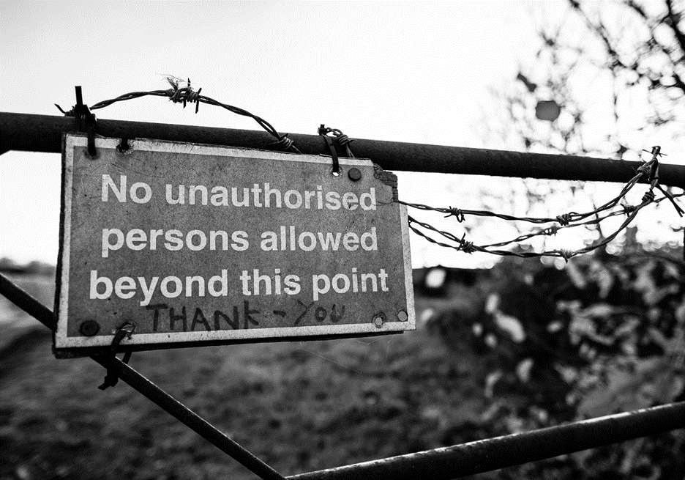
DRA Example
You arrive at a delivery address and see this sign – what would you do?

Slide 6
DRA Example Discussion Points
What sort of questions would you ask yourself as you make a DRA?
Should I go in? Think about whether you are on your own and therefore more vulnerable, whether your vehicle is suitable for the terrain etc.
Do I know or can I see what’s beyond the gate?
Does my mobile phone work here if I need to seek assistance?
Can I get further information before making a decision? For example, is there a telephone number for the premises I can ring to let them know I’m here and ask them to come to the gate?
Should I get in contact with my office to let them know I‘m here, what I’ve found and get advice?
Does it feel safe?

Slide 7
DRA Example
<Insert an example relevant to your work here>

Slide 8
Do You Need to Record DRAs?
Most DRAs do not need to be recorded unless your employer asks you to.
But you should let your employer know if you have come across a hazard or a risk which can be added to the risk assessment for the activity.
Your employer can then fully assess and manage the risks in the future.

Slide 9
Don’t Underestimate Your ‘Gut Feeling’
If you feel that a work activity is unsafe then you must withdraw and seek advice before proceeding.

Slide 10
Conclusion
Any questions?
Remember ‘work safe, go home safe’.
Always check with your manager or supervisor if you have any concerns about this or other health and safety matters.

